Slide 1
Analysis on Electric Vehicle market in USA
Malarvizhi Shanmuga Pandian

Slide 2
Table of Contents
Introduction
Problem statement
Data Source and Description
Data Preparation
Data visualization
Electric Vehicle charging station
Electric Vehicle registered
Electric Vehicle Manufacturer
Conclusion

Slide 3
Introduction
Electric vehicle market is growing at a rate more than anticipated growth rate
Electric vehicles (EVs) main source of energy is electricity, and no combustion engine is present in the vehicle
Few reasons that EV market is on raise could be environmental impact of traditional gasoline vehicles, increase in fuel prices and favorable government subsidies
Evs are divided majorly into three segments – Battery Electric Vehicles [BEV], Hybrid Electric Vehicles [HEV], and Plug-In Hybrid Electric Vehicles [PHEV]
Electric vehicle market was valued at USD 273.31 billion in 2020 and is projected to reach USD 802.75 billion by 2028

Slide 4
Problem Statement
Few of the questions that are expected to be answered by doing this analysis are:
Which brand or model EV car is popular in the market and preferred mostly by the people? Is it due to mainly which factor – price range, fuel efficiency, economy rate, etc.?
Is having an easily accessible charging location, the main reason for opting for an EV than traditional cars?
Geographical concentration of EV and charging ports – to understand the pinpoint location of charging stations and the count of EV registered in that area.
Some of the states in USA needs to be analyzed in detail to conclude on the type of regions where people are moving towards electric vehicle. If it is highly considered among city/metro regions or also in suburban?

Slide 5
Data Source
Electric vehicle population data → Department of Licensing
Specific information about EV like location, model year, energy utilized.
Electric vehicle charging station data → U.S Department of Energy targeting electric stations
Data about the charging station location, private/public, rapid charge or not, number of ports.
Types of EV and brands in the market data → Kaggle
Details like brand, model, speed pickup, top speed, efficiency of fuel usage, etc.

Slide 6
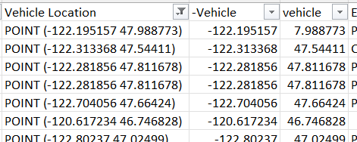
Data Preparation Steps
Vehicle Registration Data
Removed unwanted columns for visualization – VIN number , DOL Vehicle ID, Legislative District
Removed rows with blank values in these columns. Note the number is the row count after deleting rows each column
County –> 91925
Model –> 91908
Base price = 0 -> 4406
Vehicle Location -> 4373
Vehicle location split into Latitude and
Longitude values

Slide 7
Data Preparation Steps
Fuel Stations Data
Removed unwanted columns for visualization –Station Name, Street Address, Intersection Directions, Station Phone, Cards accepted, Geocode Status, Date Last Confirmed, and 14 more columns
Removed rows with blank values in these columns
EV Connector type –> 50495
Zip = 0 & alphanumeric value –> 50476

Slide 8
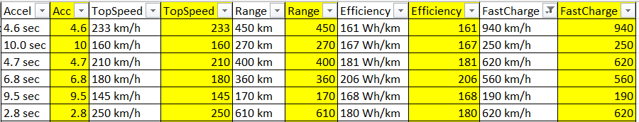
Data Preparation Steps
Vehicle specs and brand Data
No unwanted columns in this data
Removed rows with blank values in these columns
FastCharge –> 98
Removed letters in columns to get numbers

Slide 9
Data Visualization Tool used
It is planned to use Tableau to visualize the data using different graphs, as Tableau got many variety of graphs
Leveraged, the US map graph to visualize the location of charging stations and the state-wise EV registration count. This will help in understanding the placement of each
Graphs in which allows visualization of more than two features helps in avoiding dashboard comparison later

Slide 10
Analysis on EV charging stations

Slide 11
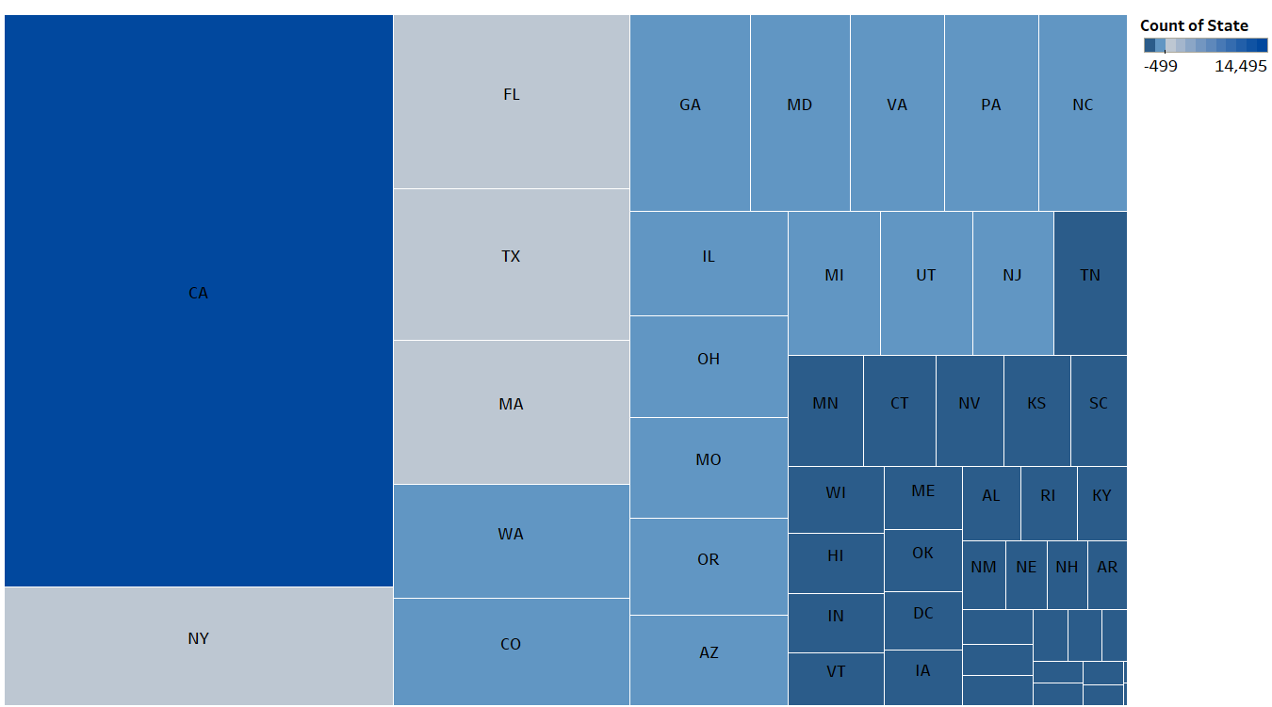
EV charging stations
Size of the box represents the total number of EV charging station in each state
California has total of 14.5K charging stations and is the highest for a state in USA
Trailing behind are New York, Florida, Texas, Massachusetts, Washington states
Difference between second highest state NY - 3k and CA – 14.5k is alone 11502
States like Oregon, Arkansas, South Dakota has less than 100 stations

Slide 12
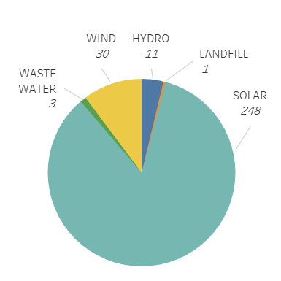
On-site renewable energy
Out of all the charging stations, total of 293 stations use renewable energy
84.6% of those, use solar to produce energy
Wind is the source of producing energy in 10% of these stations
Renewable energy fulfills only part of the total energy need

Slide 13
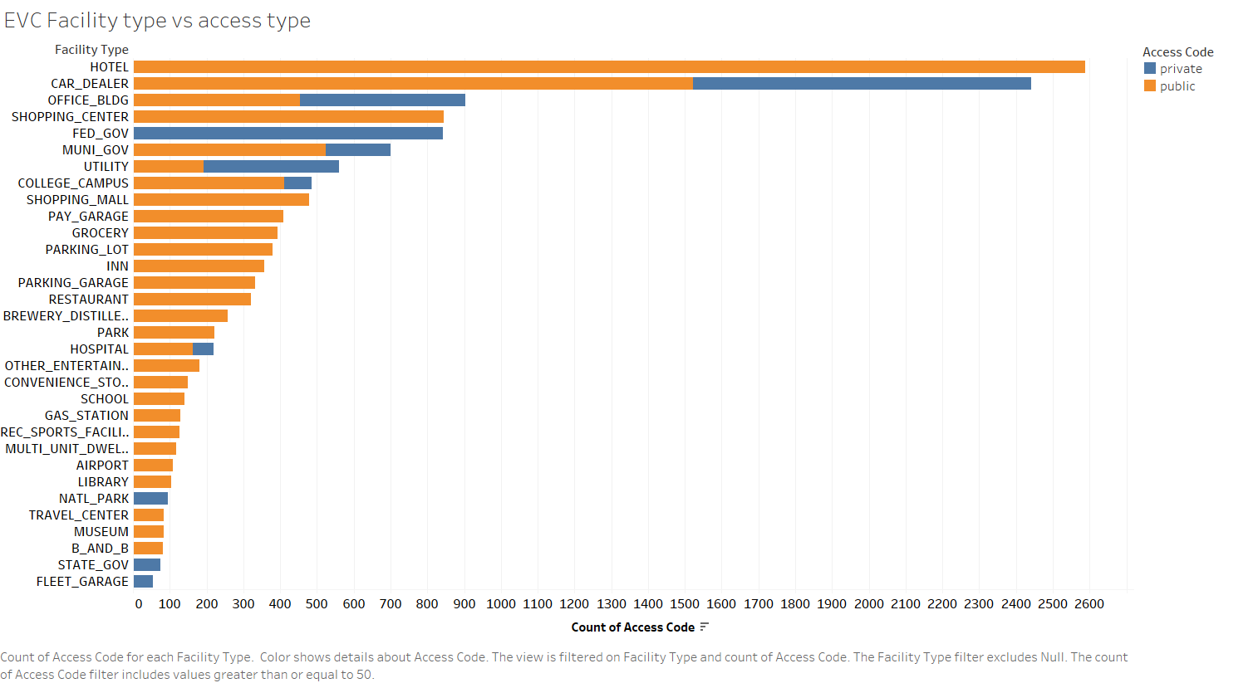
EVC facility type
EVC that are present in combination with other facilities are plotted where the color denotes access type
Public EVC are open to everyone whereas private EVC can be used only by people with access card
Highest count of EVCs are seen in hotels(2.6k) and all of federal government buildings has private charging stations

Slide 14
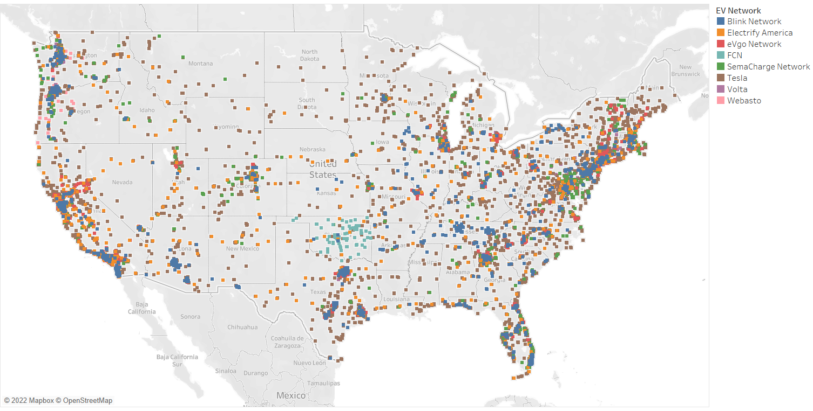
EVC location
EVC concentration is seen to be more on west coast and east coast region, especially California and New York
Tesla covered all the states, Blink stations are available in concentrated locations across many states.
FCN is available only in Oklahama and Webasto is seen only in Washington and Oregon

Slide 15
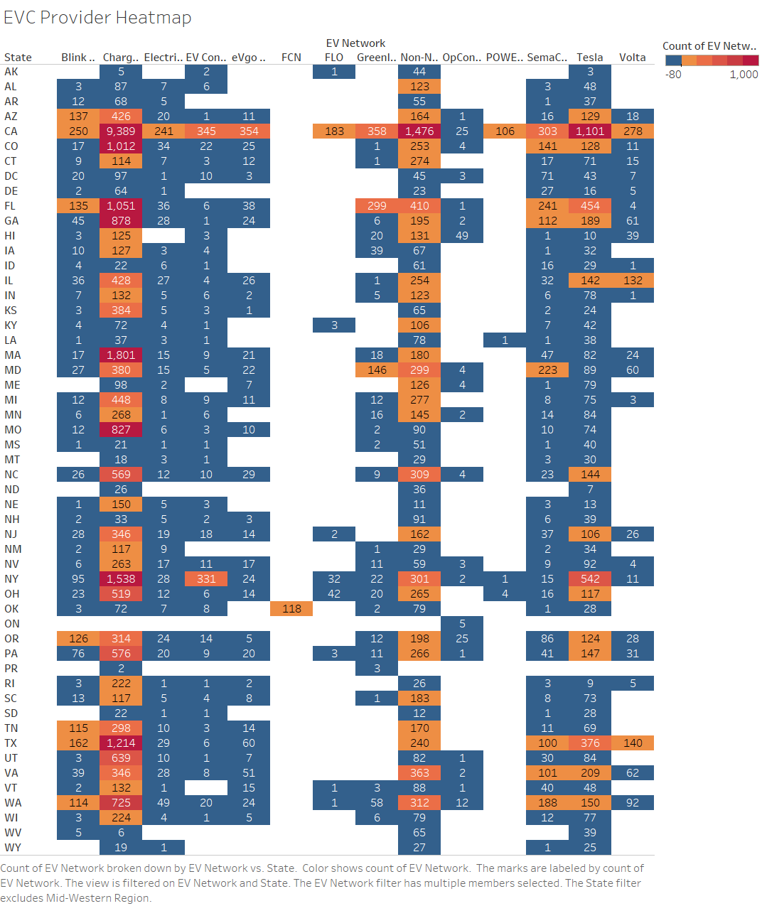
EVC count
Only network having more than 100 stations across US is visualized
ChargePoint network has got a greater number of stations in all the states with total of 26.8k
Number of stations by network is as follows:
Blink – 1620
SemaCharge – 2039
Tesla – 5747
Volta – 1058
Non-networked - 8597

Slide 16
Analysis on Electric Vehicle registered

Slide 17
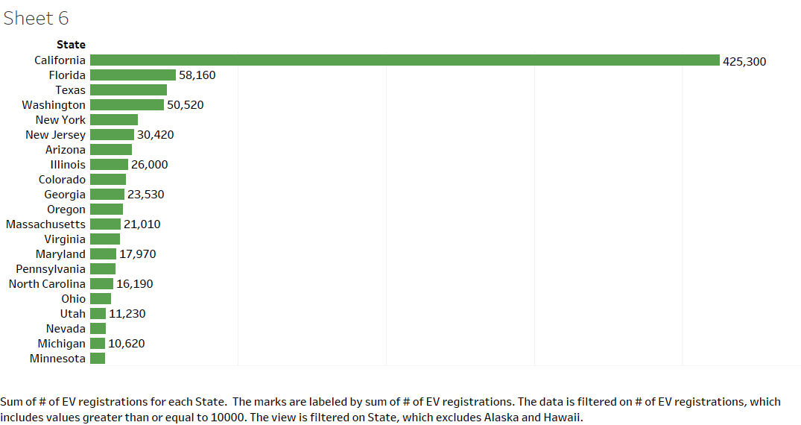
Number of EV registered
This data is depicting count as of Dec 31st, 2020 and considering only BEV
Just like EVC count, California has most number of EV registered which is followed by Florida, Texas, Washington, New York and New Jersey in the same order.
California got 86.3% more vehicle registered than Florida, which is second largest.
Bottom three states with lowest count are North Dakota(220), Wyoming(330) and South Dakota(410)

Slide 18
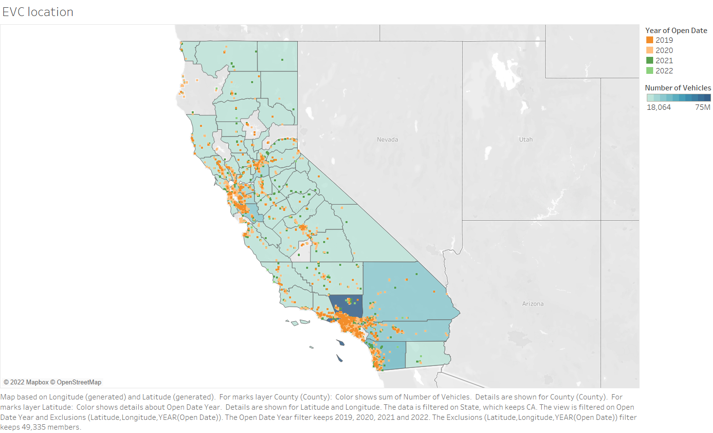
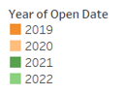
CA – EV and charging stations
Highest number of electric vehicle registered is in Los Angeles county, followed by Sacramento, Santa Clara, San Diego, San Bernardino.
Color denotes different years between 2019 and 2022, in which the charging stations are established
There is an expansion of new stations seen every year around the existing stations

Slide 19
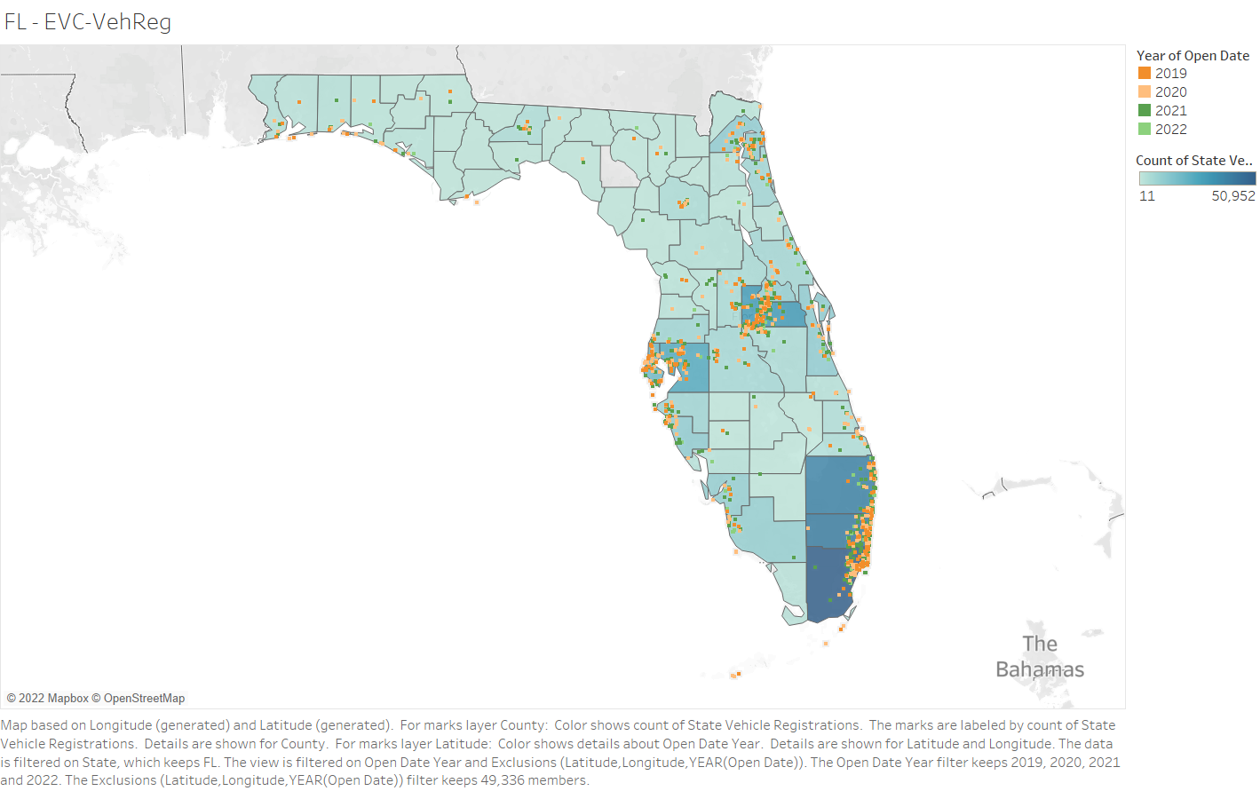
FL – EV and charging stations
In Florida, Dade county has highest vehicles registered with total of 50.9k
Broward and Palm Beach counties also has also above 35k in each county
More concentration of EVC is alongside the east coastal line and also in Orange county

Slide 20
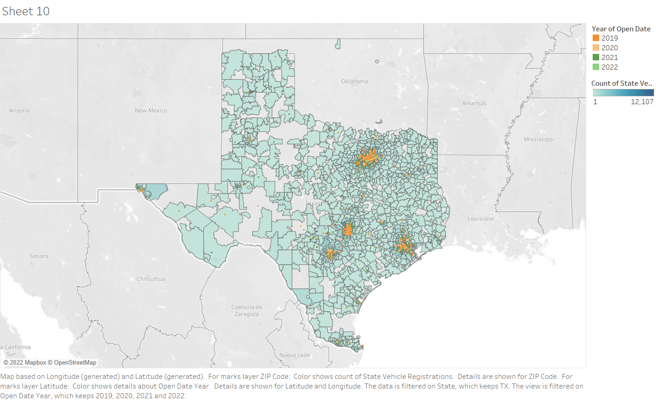
TX – EV and charging stations
In Texas, the vehicle concentration is shown for every zipcode.
The concentration of both electric vehicle and charging stations are on four major cities in Texas.
They are Dallas, Austin, Houston and San Antonio.

Slide 21
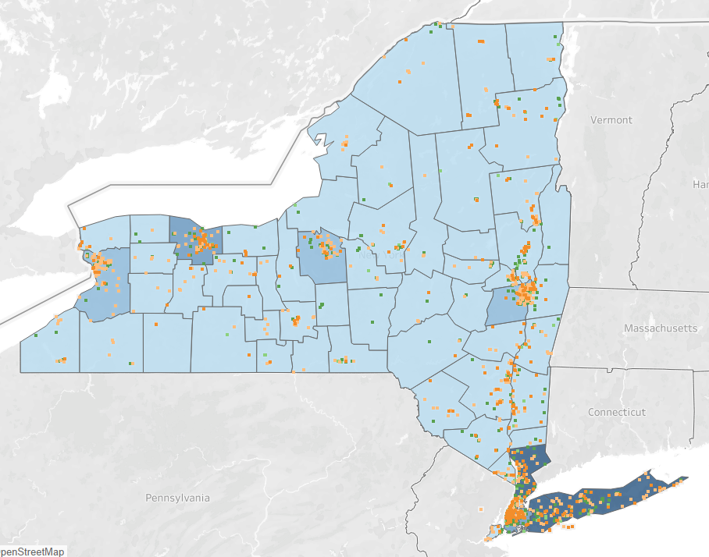
NY – EV and charging stations
Suffolk(14856), Westchester(10217), Nassau(12589) counties are having more number of registered EVs
EVC concentration is more in these counties, but Albany county has also got more EVC but less number(2210) of EV
Unlike California, New York state has very scarcely located charging stations

Slide 22
Analysis on EV manufacturer and models

Slide 23
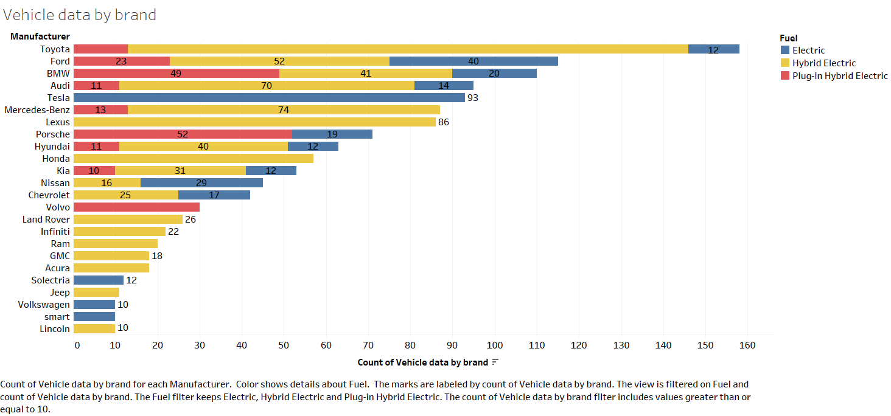
EV model cars by brand
Only light vehicle is considered for visualization here
Different color denotes fuel type of the car
Toyoto has highest number of vehicles in this three fuel segments. More vehicle belongs to hybrid electric segment
Tesla released total of 93 models with only electric fuel type similarly Solectria, Volkswagen, Smart
Ford, BMW and Audi seems to have more competition in the top rankings

Slide 24
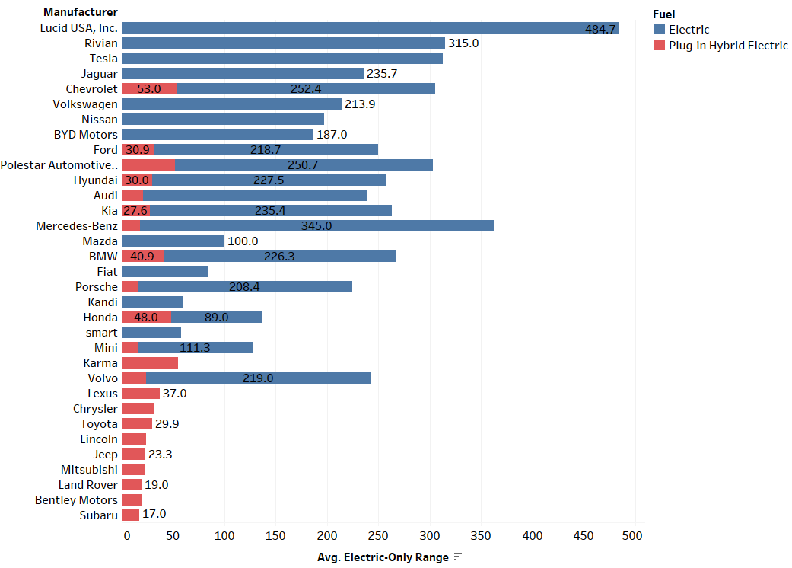
Electric-only range
Lucid USA, Inc car provides topmost electric range of 484.7 miles
In hybrid vehicles, Chevrolet got 53 miles as average range covered in electric fuel
Rivian came to market only in 2022 but has high range of 315 miles competing with Tesla (312.4 miles)

Slide 25
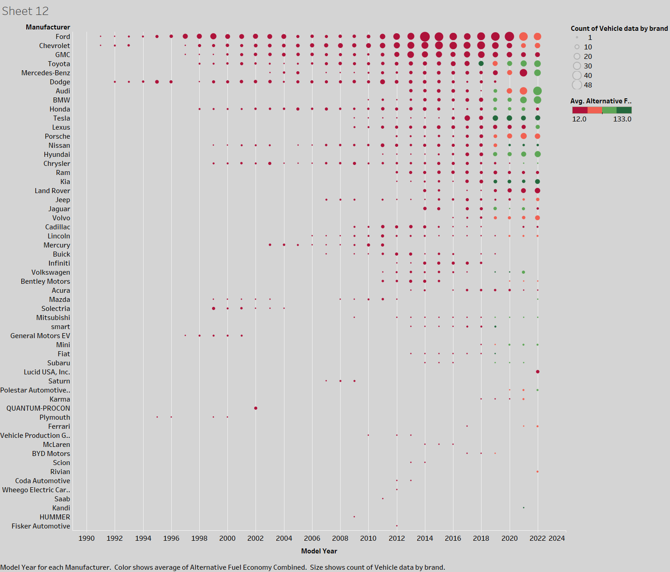

Slide 26
EV market with economy rate
The earliest electric fuel vehicle introduced by Ford and Chevrolet in the year 1991
The size of the circles in the graph denotes the number of different car models released by a particular manufacturer in the year
Highest of 48 different model electric cars released by Ford in the year 2014
Different color denotes average economy rate of the car in a year.
Tesla and Kia maintains good economy rate in their consistently above 100 miles for one fill-up for the past 4 years
Number of models released every year is only increasing every year

Slide 27
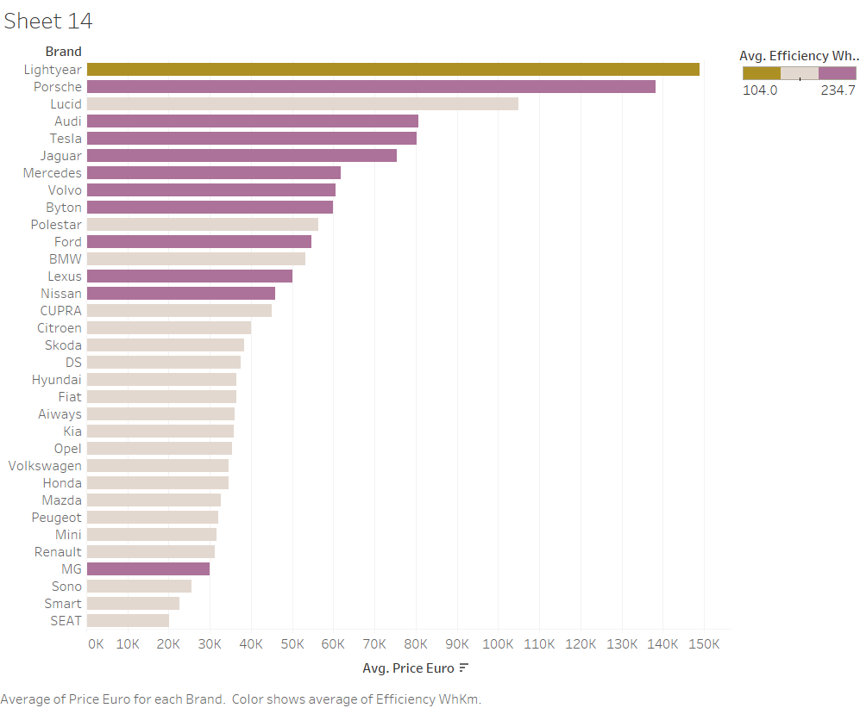
EV price vs Efficiency
Higher the WhKm value less efficient is the EV
Lightyear brand has the high-priced car but with best efficiency of 104 WhKm. It means for every Km traveled; the EV consumes 104Wh of power
Medium range efficient cars are from brands like Tesla(201), Ford(202), Porsche(209) and few more
Porsche is still on the costly side, whereas Tesla, Audi, Jaguar are almost in the same price range
MG is an outlier car where the EV is more efficient and less cost

Slide 28
Conclusion

Slide 29
Is accessible charging station is a reason for electric vehicle purchase?
YES!
Based on the detailed analysis done by comparing both electric vehicles and the charging stations in all the top states in USA, made it clear that more charging stations are placed in counties where the number of EV on road are high
Other locations in the state, where a smaller number of charging stations are located, vehicle owners must be using in-house charging options

Slide 30
Preferred manufacturer for EV and its performance
Comparing different brands of EV there are few conclusions:
Ford has more options to chose from and the price, electric fuel range, efficiency, economy rate are in average range
Only electric vehicles seems to give better performance and comparatively less price
High end car brands like Porsche, Audi, Jaguar, BMW are not great options to buy EV as most of the models are hybrid cars and they provide less value in terms of electric fuel
Kia seems to have shown great numbers in terms of electric-range, price, economy rate but is less efficient
Tesla fits very well in all numbers but on a slightly high price than other competitors like Kia, Ford, and Chevrolet.

Slide 31
Is the type of region influencing people in buying EVs?
From our analysis, it is the same pattern repeats in every state that there is high numbers recorded both for EV and charging stations
Difference in the amount of purchase is very high from other sub-urban regions of the state
One of the possible reasons for this distinctive difference can be because the distance travelled between places in sub-urban is more than in cities.
And electric vehicle is supposedly having dependency on charging stations and give less range than gasoline traditional cars

Slide 32
References
https://www.energy.ca.gov/files/zev-and-infrastructure-stats-data
https://www.atlasevhub.com/materials/state-ev-registration-data/#data
https://data.amerigeoss.org/dataset/electric-vehicle-population-data
https://data.amerigeoss.org/dataset/electric-vehicle-title-and-registration-activity
https://afdc.energy.gov/data_download
https://www.kaggle.com/datasets/geoffnel/evs-one-electric-vehicle-dataset?select=ElectricCarData_Clean.csv
https://electrek.co/2021/08/24/current-ev-registrations-in-the-us-how-does-your-state-stack-up/#h-ev-registrations-continue-to-grow-in-the-us

